Slide 1
WELCOME | Thank You For Joining

Slide 2
SERIES OVERVIEW
Session 1 | The Good God
Session 2 | The Trustworthy God
Session 3 | The Generous God
Session 4 | The Liberating God
Session 5 | The Fulfilling God
Session 6 | The Life-Giving God Session 7 | The Joyful God

Slide 3
SERIES OVERVIEW
Session 1 | The Good God
Session 2 | The Trustworthy God
Session 3 | The Generous God
Session 4 | The Liberating God
Session 5 | The Fulfilling God
Session 6 | The Life-Giving God Session 7 | The Joyful God

Slide 4
WATCH
DISCUSS
WATCH
DISCUSS
Watch a 10 Minute Film
Discuss The Film For 5 Minutes
Watch a 15 Minute Film
Talk Through The Session For 25 Minutes

Slide 5
YouVersion Bible App
WAYS YOU CAN READ ALONG WITH US
BibleGateway
www.biblegateway.com
www.youversion.com or available at
App Store

Slide 6
SESSION 1 | THE GOOD GOD

Slide 7
*EMBED FILM*

Slide 8
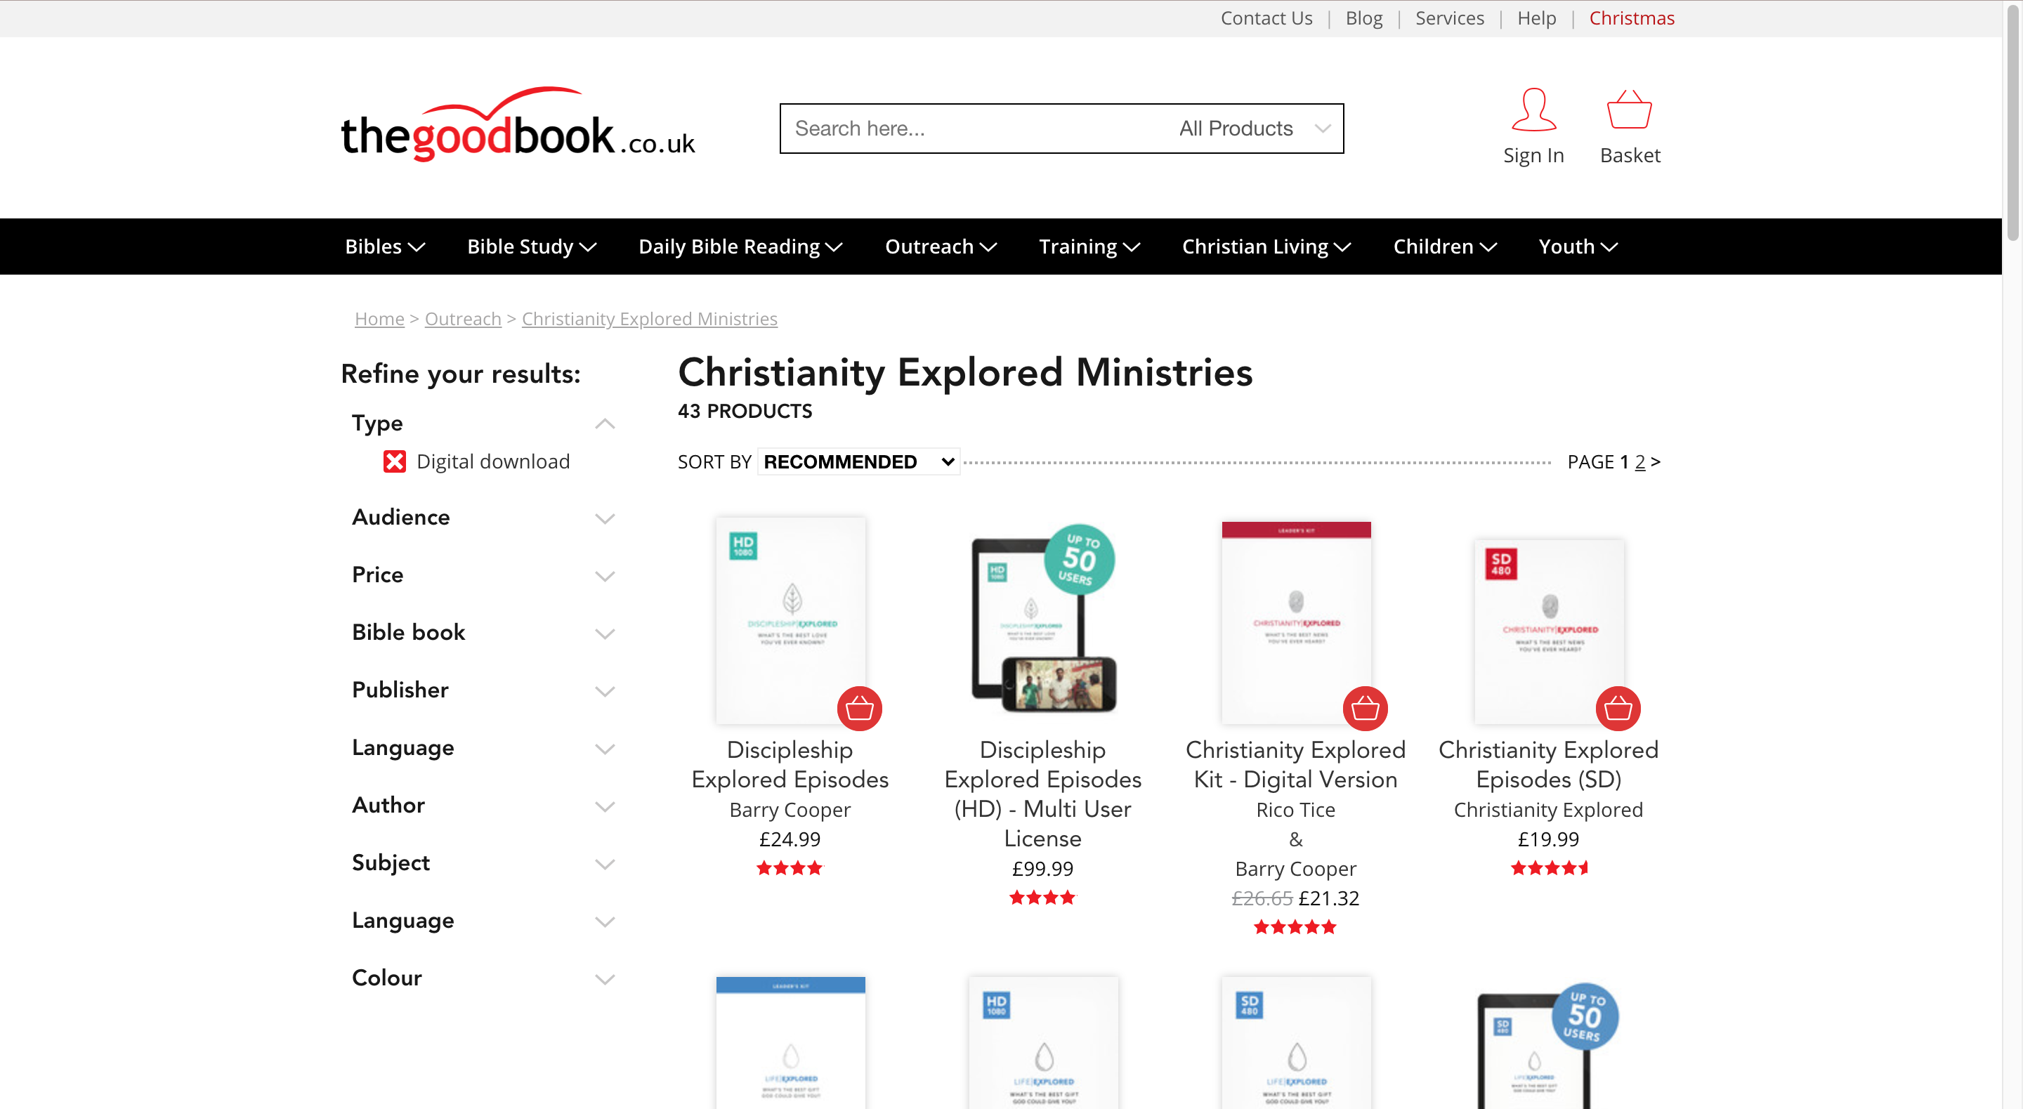
*delete slide before running course*
How To Access Video Content:
You can purchase the video content for the course at the Good Book Company:
https://www.thegoodbook.co.uk/outreach/cem/resource_type-digital-download/

Slide 9
SESSION 1 | THE GOOD GOD
DISCUSS
What is the best gift God could give you?

Slide 10
SESSION 1 | THE GOOD GOD
READ
Genesis 1:27-31
“God created mankind in his own image,
in the image of God he created them;
male and female he created them.”

Slide 11
*EMBED FILM*

Slide 12
*delete slide before running course*
How To Access Video Content:
You can purchase the video content for the course at the Good Book Company:
https://www.thegoodbook.co.uk/outreach/cem/resource_type-digital-download/

Slide 13
SESSION 1 | THE GOOD GOD
READ
Psalm 19
“The heavens declare the glory of God;
The skies proclaim the work of his hands.”

Slide 14
SESSION 1 | THE GOOD GOD
DISCUSS
1. According to verse 1, the heavens and the skies are telling us something. What is it?
2. When and where can that message be heard, according to verse 2-4?
3. Let’s take a look at verse 4. It says, “Good has pitched a tent for the sun”. What do you think we’re being told here about. What God is like?
4. From verse 7 onwards, the writer begins talking about ”the law of the LORD”, the Bible. What do verses 7 and 8 say about God’s words, and the effect they will have on us if we listen to them?

Slide 15
SESSION 1 | THE GOOD GOD
DISCUSS
5. Think of the popular views many people have about God. How does the God we’ve seen in Genesis 1 and Psalm 19 differ from some of these?
6. If you knew Psalm 19 was true, how would it affect the way you feel about God?
7. What has been most striking for you during this session?

Slide 16
NEXT WEEK :
SESSION 2 | THE TRUSTWORTHY GOD

Slide 17
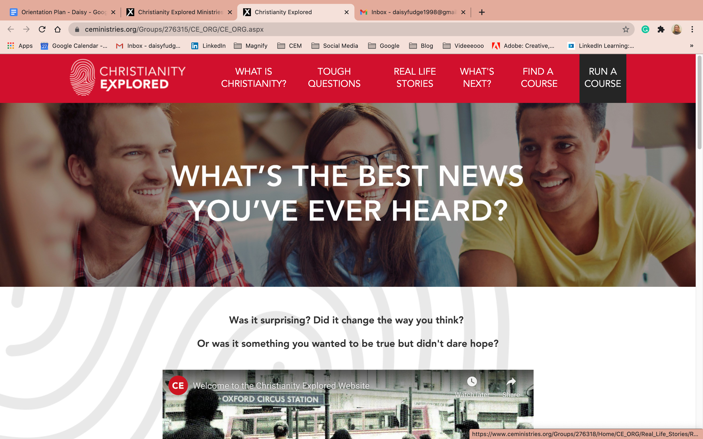
Find out more at | christianityexplored.org

Slide 18
*delete slide before running course*
How To Purchase Further Material:
You can purchase all of our content such as the leader guides, the video content and more from the Good Book Company:
https://www.thegoodbook.co.uk/outreach/cem/resource_type-digital-download/

